Slide 1
Clustering and Modelling of Sports Gambling Time Series
Aaron Foote

Slide 2
Outline
Sports Gambling
Background
Data
New Variables
Methods
PAM
Modelling
Results
Discussion

Slide 3
Sports Gambling
Sportsbook
Centralized
Line
Outcomes
Movement
BIG
1.5 Billion
Outcome vs. Pattern

Slide 4
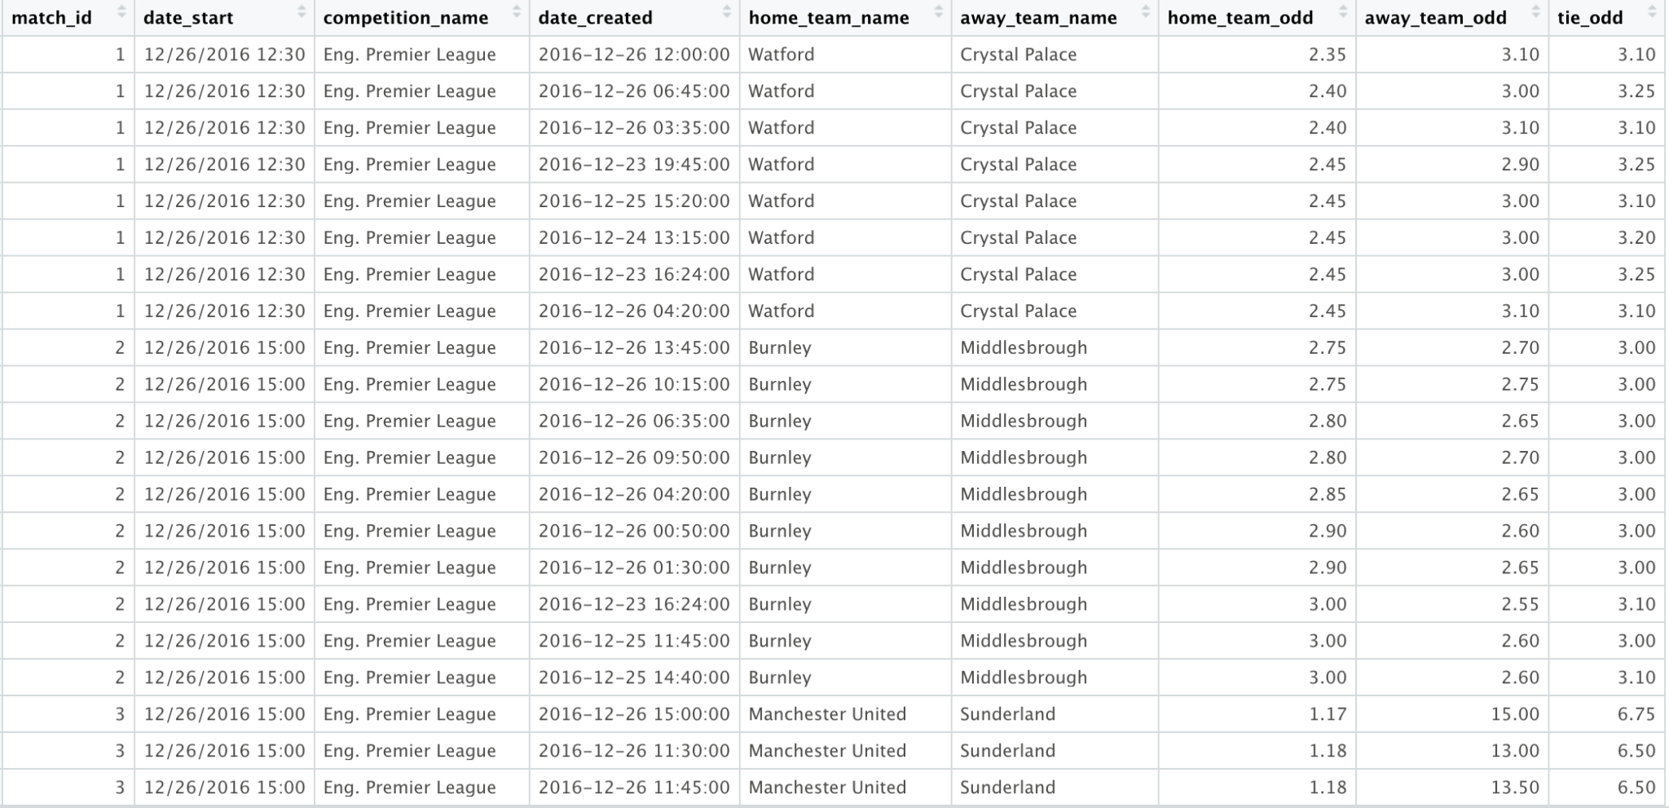
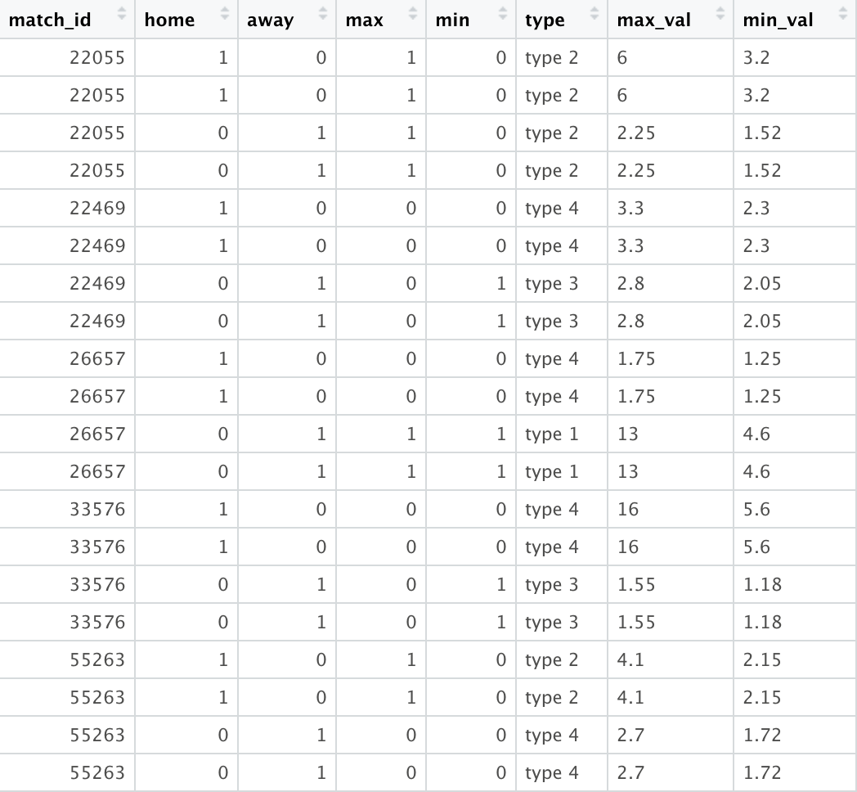
Background
id
home/away
competition
team
Leagues
Matches
TYPES
What? Why?

Slide 5
Types
Format for Clustering
Extracting Medoids
Naive, ARIMA, Spline
What’s in a cluster?
Data Management
Model Fitting
Demographics
Clustering
Evaluation
PAM
k = 2,4
Clusters
Models – Closest/Furthest

Slide 6
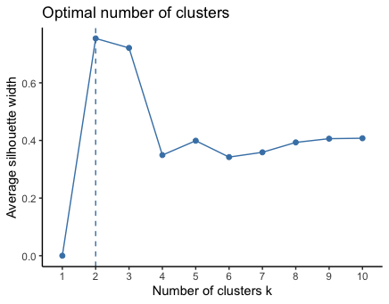
Clustering!
Use of Types
PAM
Medoids
NAs → Gower
Best Exemplar for Evaluation
Far, Close

Slide 7
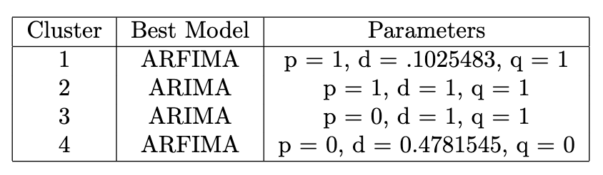
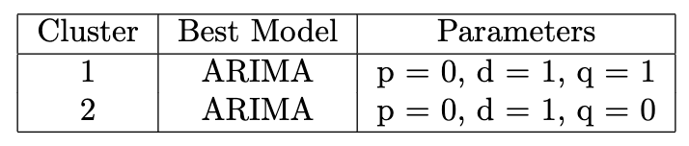
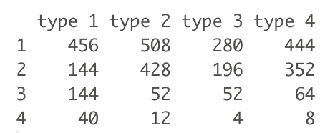
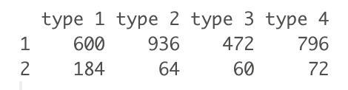

Slide 8


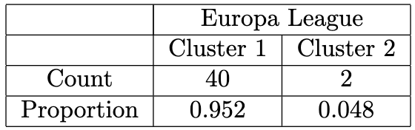
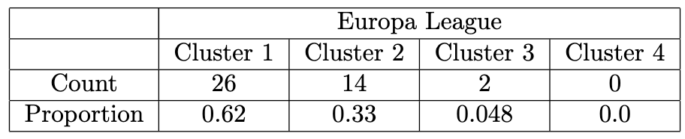
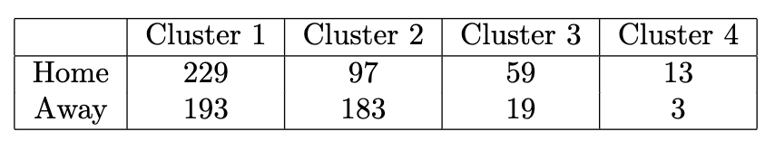
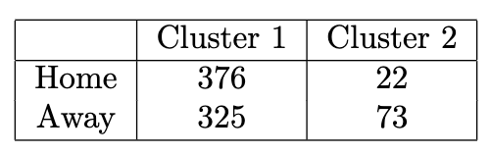
What’s in a Cluster?

Slide 9
What’s Next?
Different Clustering Algorithm
Compare medoids, cluster statistics, k
Fit more models!!
Demographics
Demographics
Demographics
Word of Advice

